Slide 1
Stores Sales Preprocessing and Analysis
By/ Shimaa Elsayed

Slide 2
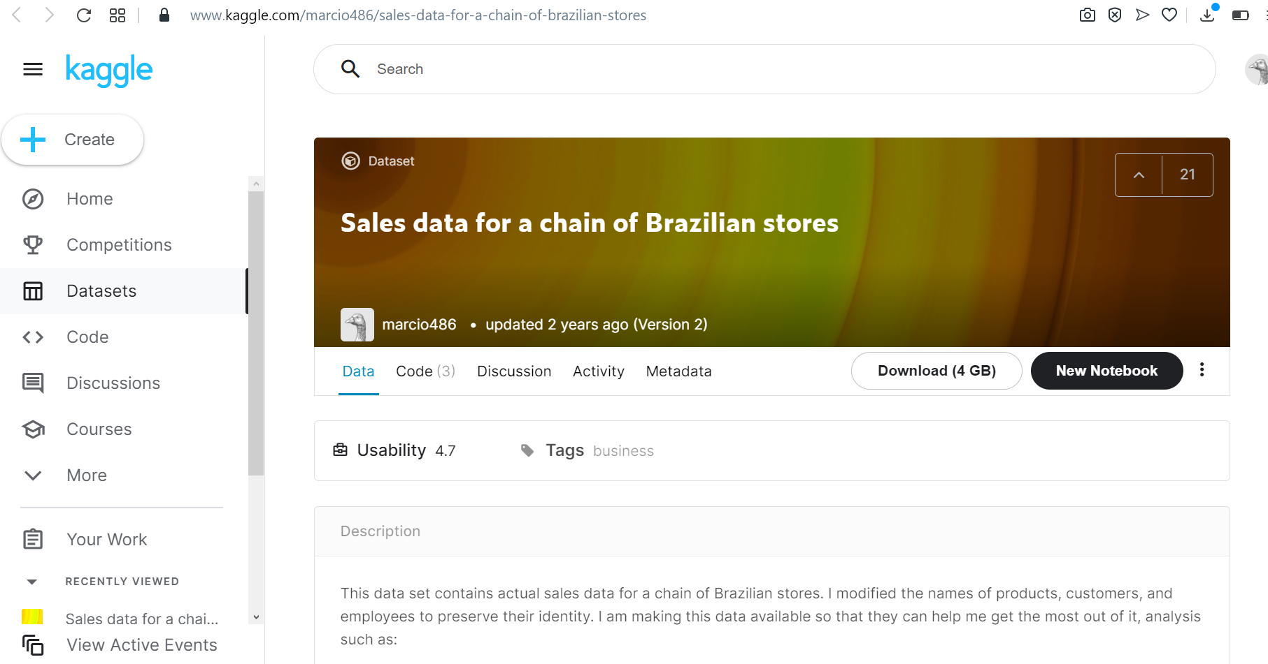
The Database

Slide 3
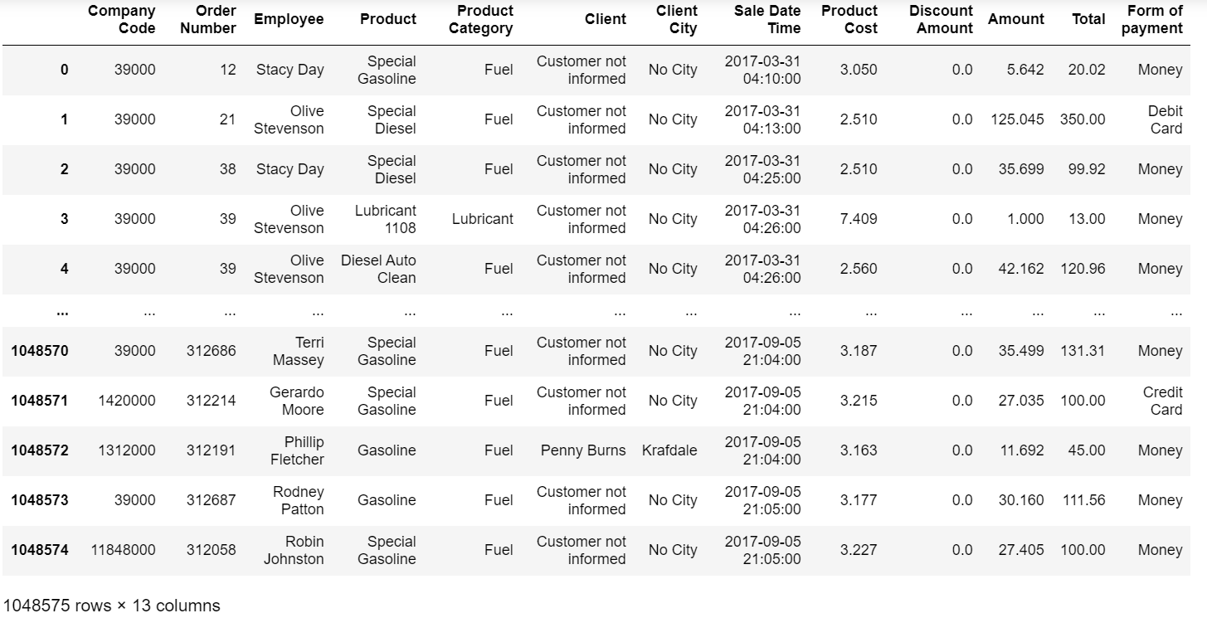
The Database

Slide 4
Index:
1- data Preprocessing and cleaning.
# null values
# datatypes readability
# finding outliers and removing them
2- sales statistics
# max and min products sold and product prices
3- data visualization
# numerical and categorical
# product cost, amount, total, form of payment, company code

Slide 5
1- Data Preprocessing and cleaning

Slide 6
a- Checking for Null Values

Slide 7
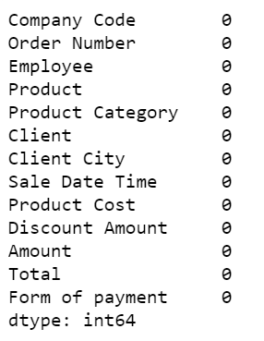
By Checking for Null values there were no null values found

Slide 8
b- checking Data Types

Slide 9
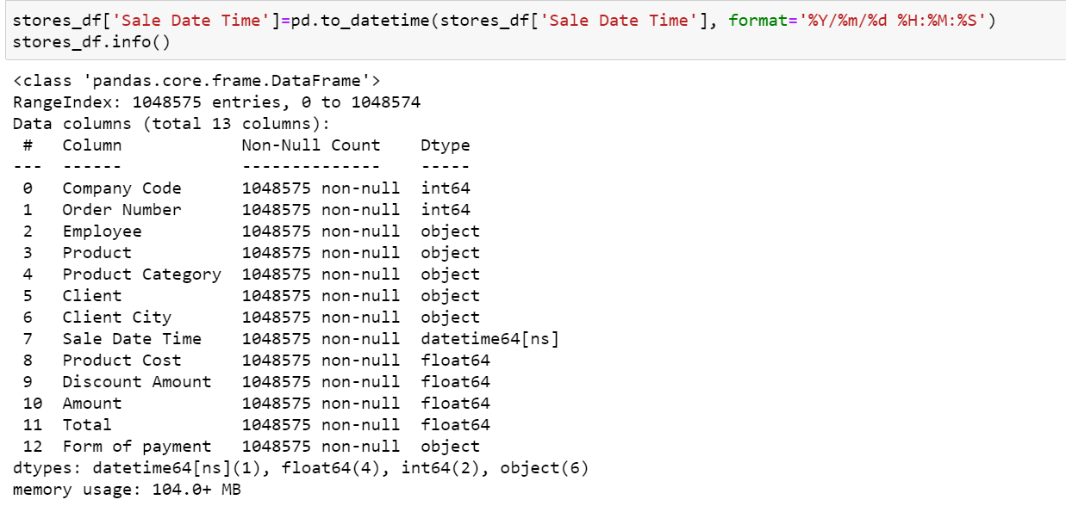
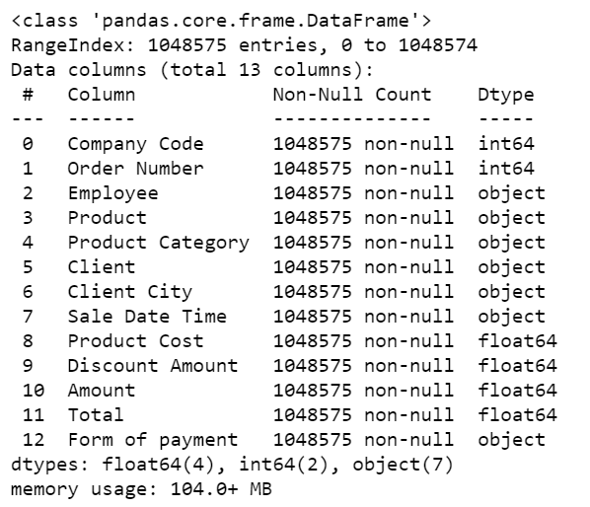
By checking data types the time and date was not recognized therefore it’s recognized by code as shown

Slide 10
c-checking for outliers and removing them

Slide 11
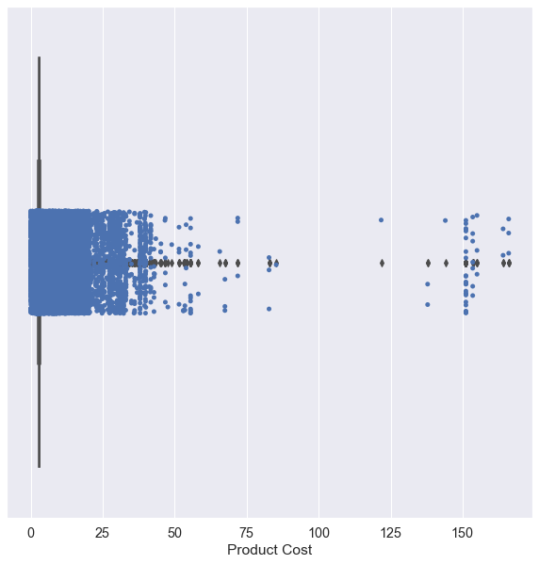
The box plot for the “Product cost” feature showing outliers

Slide 12
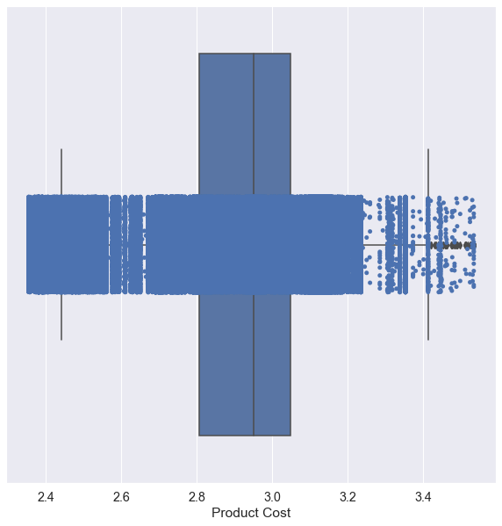
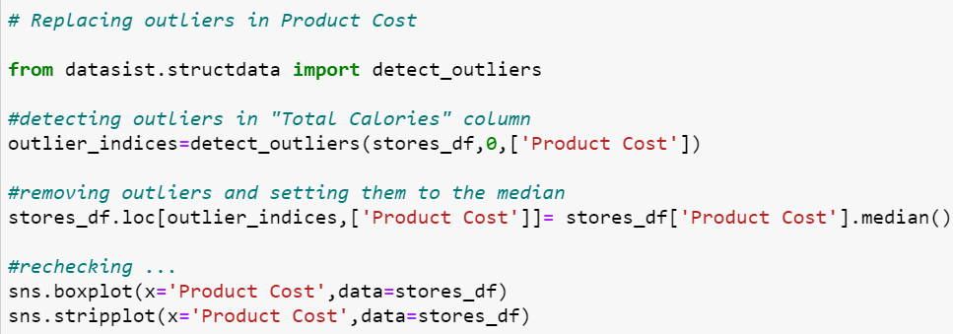
After Removing outliers
from “Product Cost” feature

Slide 13
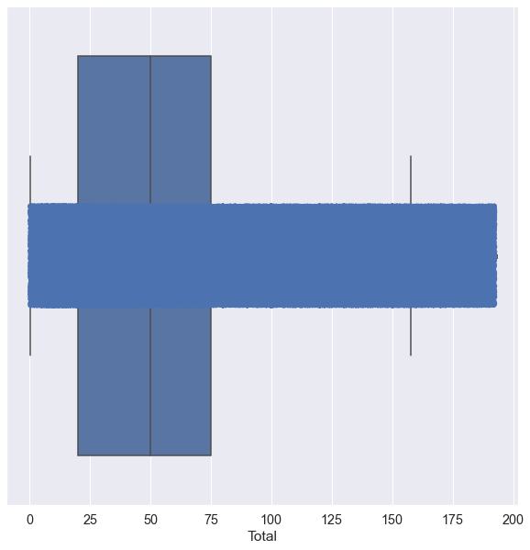
After Removing outliers
from “Total” feature

Slide 14

After Removing outliers
from “Amount” feature

Slide 15
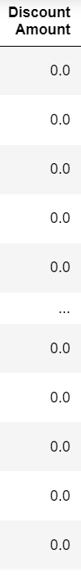
Replacing outliers in 'Discount amount' would ruin the data since most of it is zero therefore the real values are the outliers

Slide 16
2- Checking the Sales Statistics

Slide 17
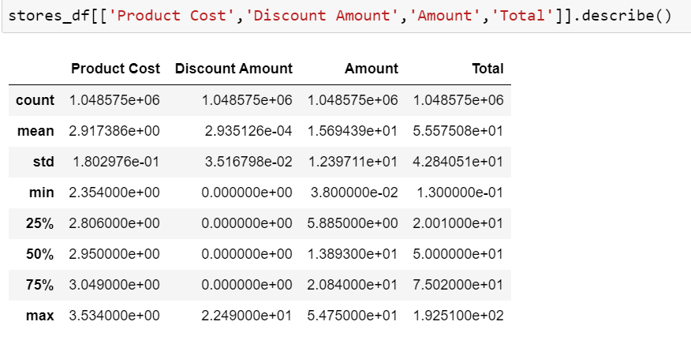
Using the describe function

Slide 18

Showing most sold products

Slide 19

Showing least sold products

Slide 20

Showing most expensive products

Slide 21

Showing cheapest products

Slide 22
3- Data Visualization

Slide 23
a- Numerical Data Visualization

Slide 24
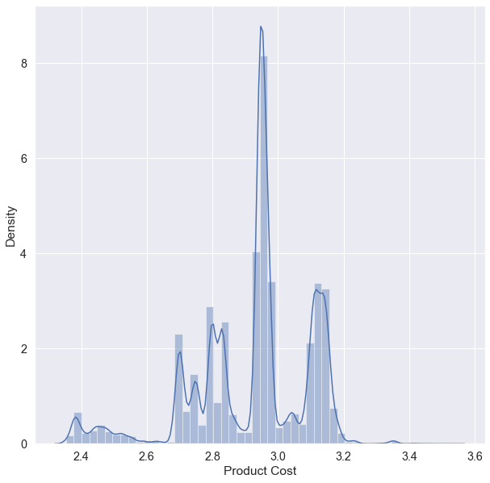
Product Cost

Slide 25
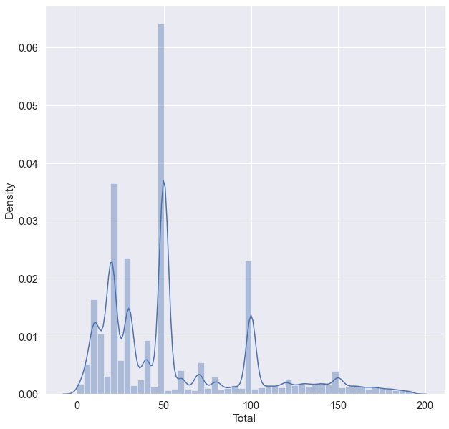
Total Cost

Slide 26
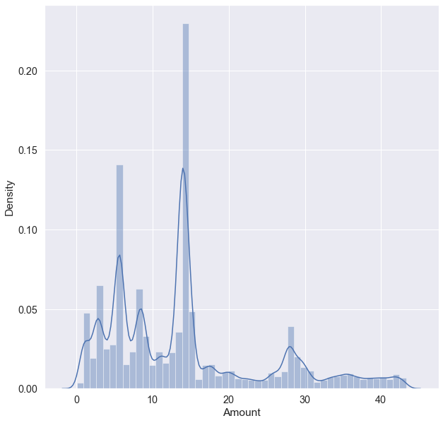
Amount sold

Slide 27
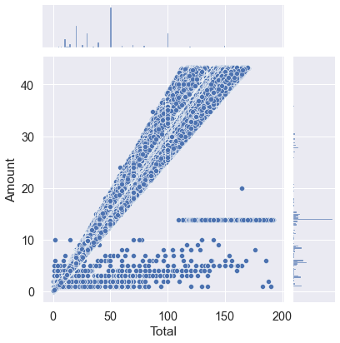
Total sold vs Amount sold
Most data is showing a directly proportional relationship as expected

Slide 28
b- Categorical analysis

Slide 29
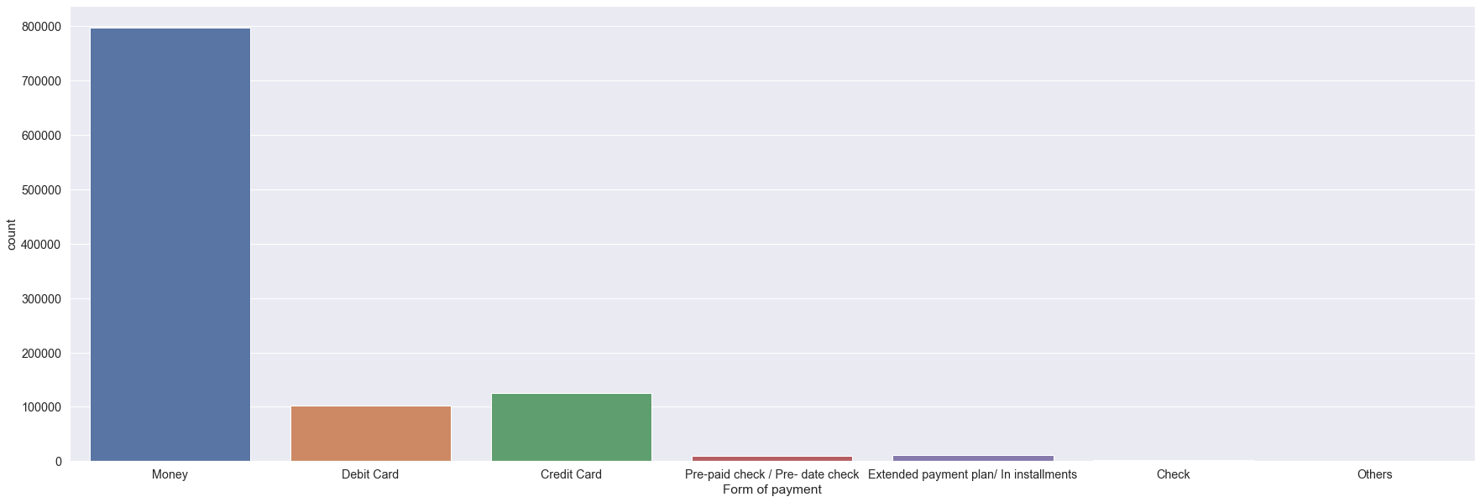
frequency of usage of each form of payment

Slide 30
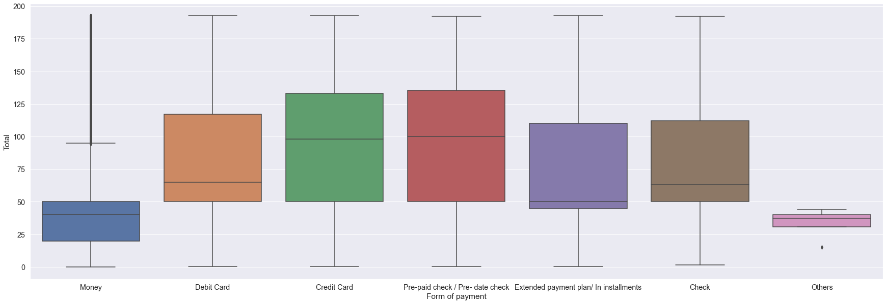
The 5 number theory with the forms of payment with the total cost of products (box plot)

Slide 31
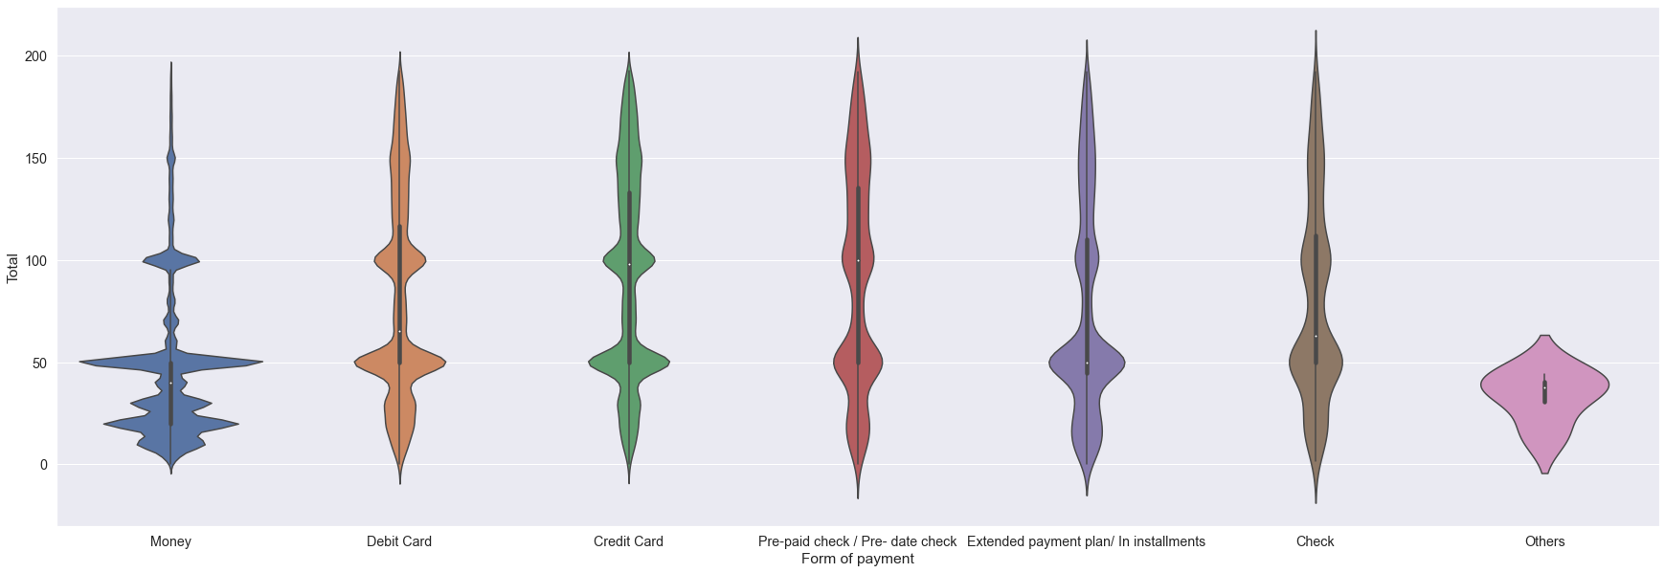
The 5 number theory with the forms of payment with the total cost of products with distribution (violin plot)

Slide 32
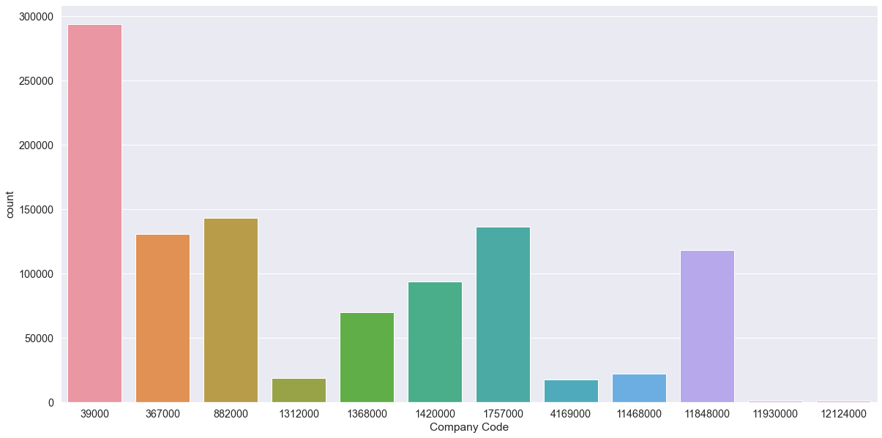
frequency of usage of each company code

Slide 33
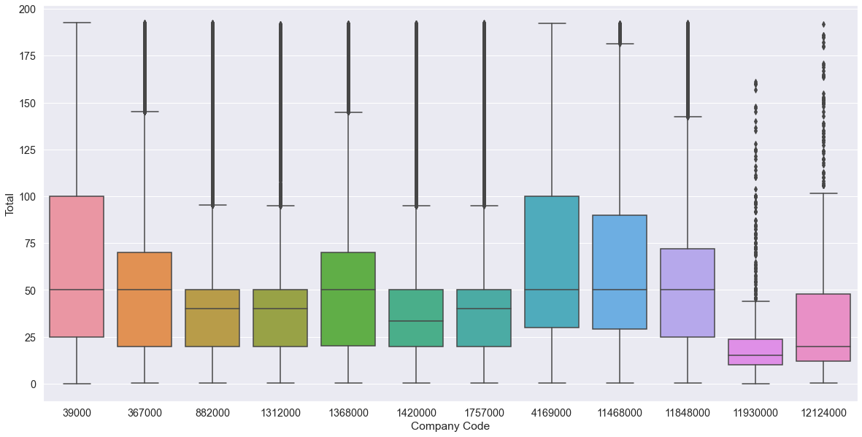
The 5 number theory with the company code with the total cost of products (box plot)

Slide 34
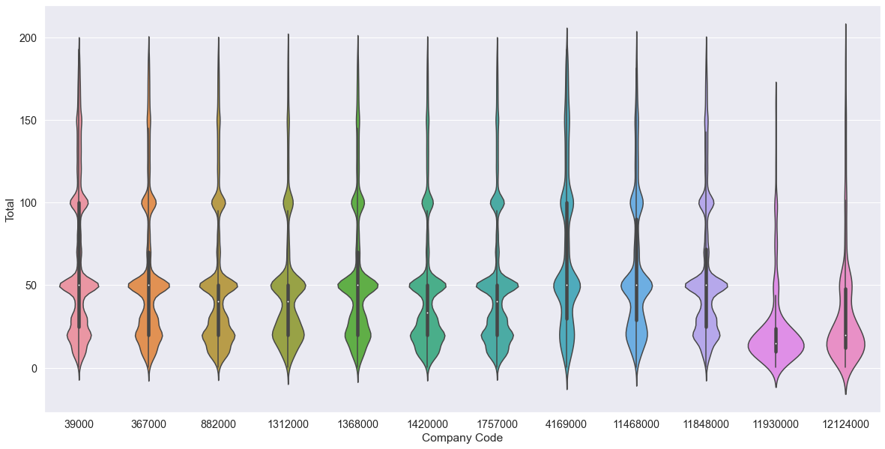
The 5 number theory with the company code with the total cost of products with distribution (violin plot)

Slide 35
Recommendation:
Recommending companies with company codes: 1312000, 4169000, 11930000, 12124000 to increase their sellings and look into products and average cost.

